Slide 1
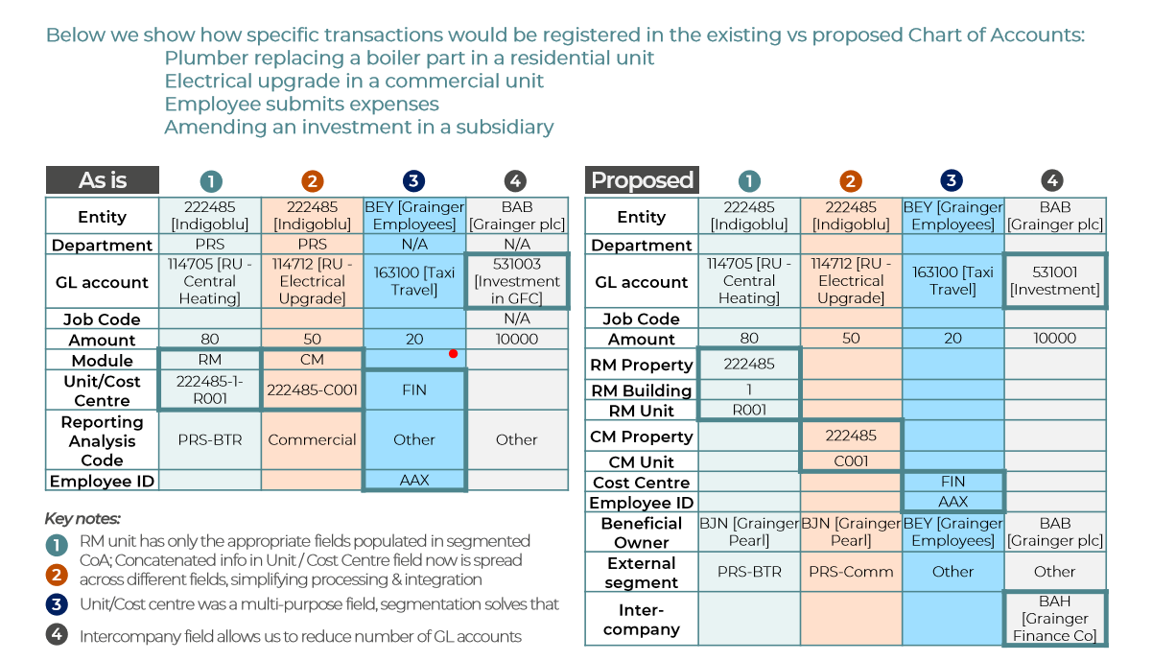
CoA scenarios

Slide 2
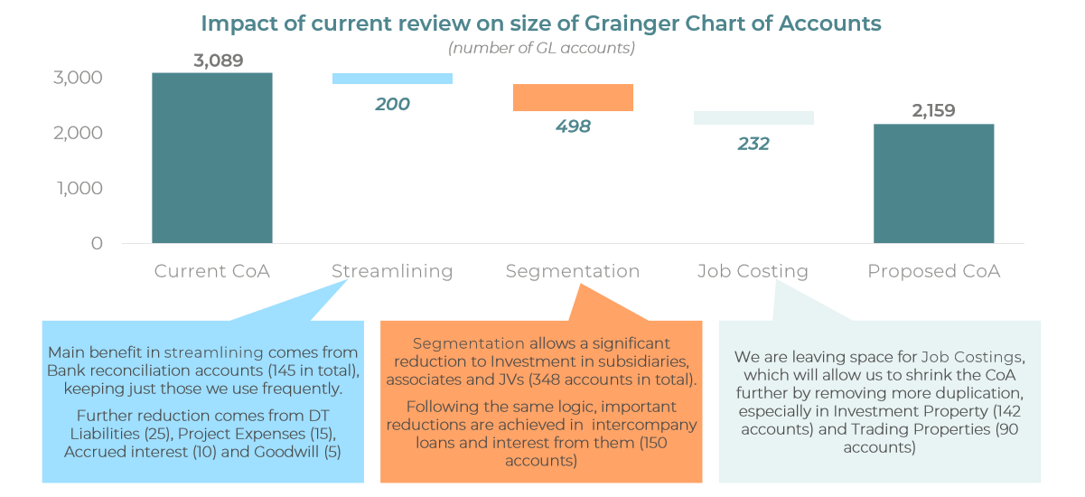
Revised size of CoA
Add back 498 GL accounts
Proposed CoA total 2657

Slide 3
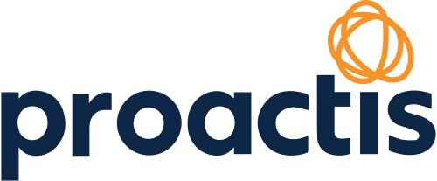


Fallback Plan to “As Is”
Interface Proactis to MRI
5 days to adjust back to original setup
Chart of accounts
Reload detailed accounts (original version excluding segmentation)
Load other supporting tables in the original unit level reporting customisation
Test MRI functionality of end to end processes already built
Training of staff with original proposal
MRI – TIME TBC
Future State
Rework needed to adopt segmentation when it is released
Training of staff to adopt segmentation
Rebuild GL accounts which are directly impacted by segmentation

Slide 4

Scenario 1 – PRS Property (no leaseholders)
Works order will be raised in FSI at the property level e.g. CC lift works
Work is done and then the WO is receipted to mark as complete
It will pass through to Proactis and create a Purchase Order (still at the property level)
Invoice received and matched to the PO
Passed through to MRI for payment (still at the property level)
In MRI AP it is booked to the supplier account and the GL entry is created in the nominal CC Lift Works at the property level
Automatic allocation proposal
Customisation routine requested would then take this cost and apportion it over all units within the property. This is expected to be done through a journal so the cost is moved out of the property level and moved in to the unit level. Nominal will still be CC Lift Works so costs can still be tracked.
Routine is to be as automated as possible – the number of units in a property should not need to be maintained manually, therefore any sold units would be removed from the allocation

Slide 5
Scenario 2 – PRS Property (with leaseholders and commercial)
Works order will be raised in FSI at the property level e.g. SC lift works but also select a Service Charge schedule
Work is done and then the WO is receipted to mark as complete
It will pass through to Proactis and create a Purchase Order (still at the property level)
Invoice received and matched to the PO
Passed through to MRI for payment (still at the property level
In MRI AP it is booked to the supplier account and the GL entry is created in the nominal SC Lift Works at the property level
Core MRI service charge functionality (Tranche 5)
In MRI all service charges are run through the CM module. For this example a property will be setup in CM which will contain a mix of units – leaseholders, commercial, and Grainger owned units. A property will also need to be setup in RM for the residential rent on the Grainger owned units.
There is standard functionality in the CM module to run the SC. This will allocate out the costs according to the SC schedules when the routine is run as year end. During the year the costs will remain in the balance sheet in the SC lift works category.
The SC schedule will recharge to all units so both leaseholders and Grainger owned units as part of this year end routine. Estimated SC will be invoiced at the start of the year and treated as an expense in the Grainger units e.g. RC Lift.
Customisation routine requested not needed in this scenario as standard functionality used.

